Slide 1
Safety on Calgary Transit
Public Safety & Enforcement Peace Officers
Notes:
Speaker #1
Questions for Crowd
1) Who’s ever been on a train or bus?
2) Who rides Calgary Transit every day?
There are prizes at the end for those who have been paying close attention and can answer our questions.

Slide 2
Peace Officers
Provide Help
Give Directions
Enforce Laws
Notes:
Speaker #2
Speak about how we provide help
Medical emergencies
Crime
Enforce the rules
Help vulnerable persons

Slide 3
How Do We Keep you Safe?
Surveillance Cameras
Help Phones
Crossing Arms, Bells and Gates
Yellow Line
Peace Officers
Notes:
Speaker #1
Dispatchers, people watching cameras, answering help phones
Cameras 24/7, someone is always watching (1300 cameras). Cameras on every bus and new trains, and at every train station
Help Phones in stations pop up on camera

Slide 4
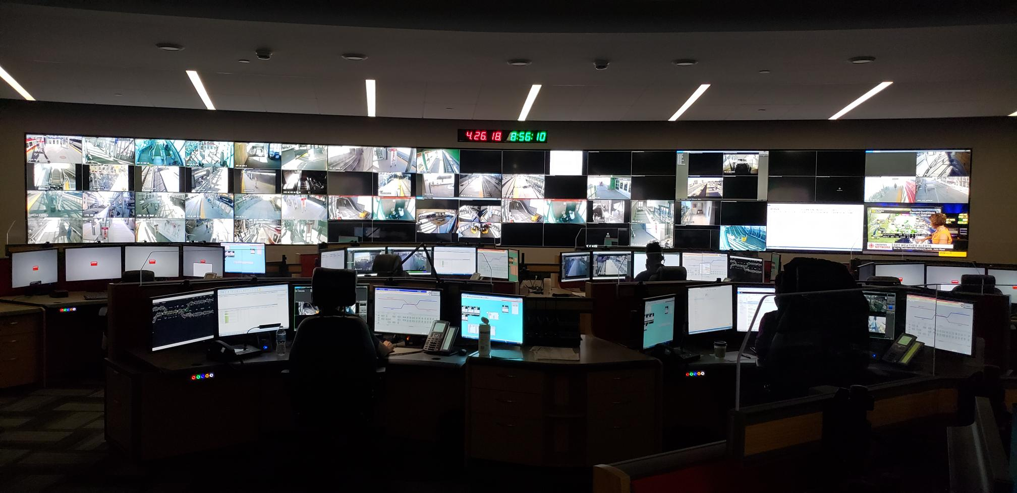
Dispatch/Surveillance

Slide 5
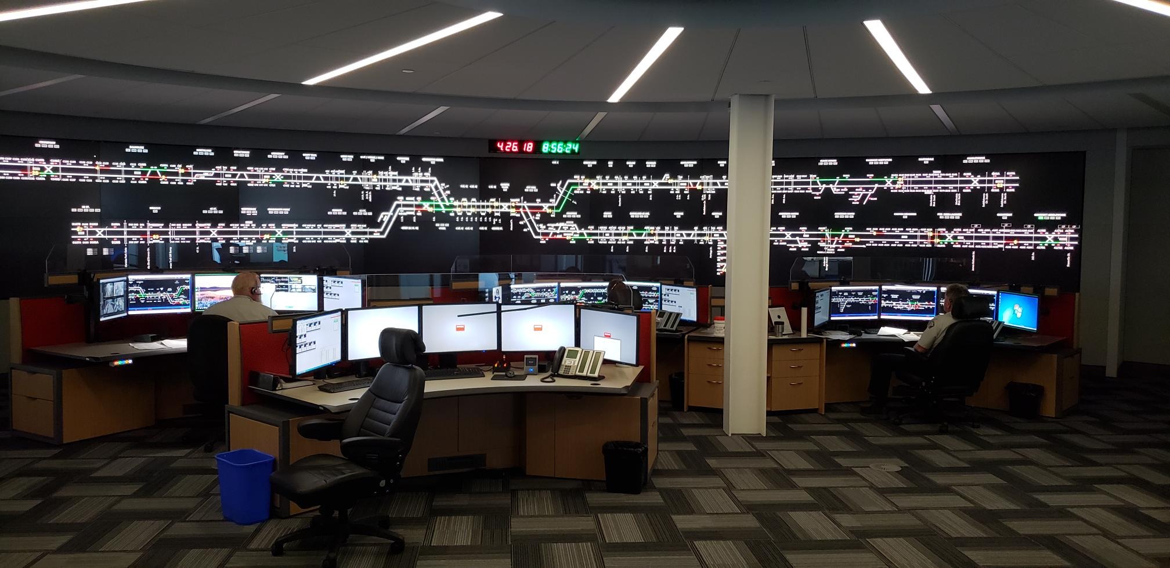
Rail Control

Slide 6
Prepare
Plan your trip
Practice your route
44 Train stations
Identify landmarks
What happens if I miss my stop or get off at wrong stop?
Identify “safe” places along route
Look online for planned service disruptions
Notes:
Speaker #1
Part of being safe includes being prepared.
Speak about trip planning resources
Calgary Transit Website
Calgary Transit App
Customer Service Representatives
Plan for at least two different ways to get to and from school in case there is a disruption on one of the routes
Practice Route
Landmarks to help identify stops
Safe places along route (places to go if you need help)
Ask bus driver for help
Family Plan
Emergency contact numbers
What to do if you get lost
Know address & phone numbers (Maybe ask question, how many people know their address and phone number off by heart?)

Slide 7
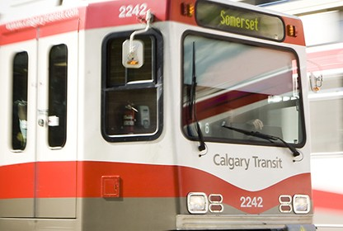
Transit Safety
1 rail car is 98,500 lbs
90 Meters for train to stop
Max speed for a train is 80 kph
Notes:
Speaker #2

Slide 8
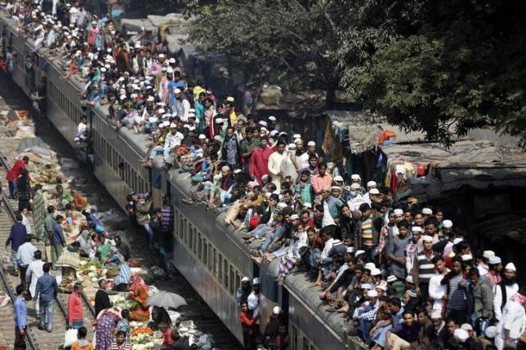
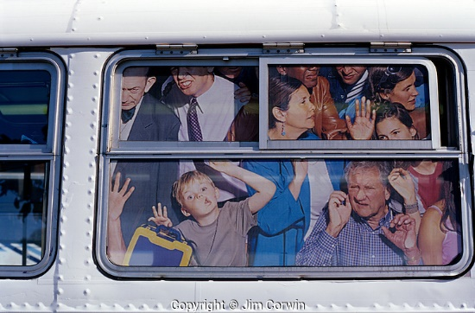
Transit Safety
Notes:
Speaker #2
Intro video
Don’t rush for train
If train is too full another will be along shortly

Slide 9
Transit Safety
Have your pass, transfer or money ready
Sit down or hold hand rail to avoid falling
Sit close to driver of bus or train
Keep bags/belongings in front and close to you.
Know where you are
Look for landmarks or signs
Pay attention
Remove ear buds
Put the phone away
Notes:
Speaker #1
Whether on train or bus these tips can help keep you safe.
Have pass, transfer or money ready to show the driver so you aren’t fumbling for it and rushing.
Sit down or hold hand rail quickly to avoid falling when the bus begins to move

Slide 10
Transit Safety
Be respectful of others
Travel in pairs or groups
Trust your instincts
Report incidents or concerns ASAP
Notes:
Speaker #1
Respectful of others
Let people off bus or train before boarding
Don’t block doors/exits
Speak at respectful levels (don’t yell, swear)
No horseplay (pushing, shoving etc)

Slide 11
C-Train Safety Tips
Stand back from the yellow line
No horseplay
Use crossings/crosswalks and look both ways.
Obey traffic signals
Signs, crossing arms & lights
Notes:
Speaker #2
Stand back from yellow line
Mirrors stick out on trains and extend onto the platform over the yellow line
Story (Kitty)
Horsing around on platform
Kids backpack crossed yellow line
Mirrors stick out
Driver had to break really hard and train couldn’t come into the station.

Slide 12
Bus Safety Tips
Remain on the curb until the bus stops and opens its doors
Sit close to the driver at the front of the bus
Ask the driver for help
To enter the bus, please use the front door. To exit, use either the front or back door
Notes:
Speaker #2
If you feel unsafe don’t get off the bus, stay on and report concerns to the driver.
If you don’t know where you are, ask the driver for help. They are there to help you.

Slide 13
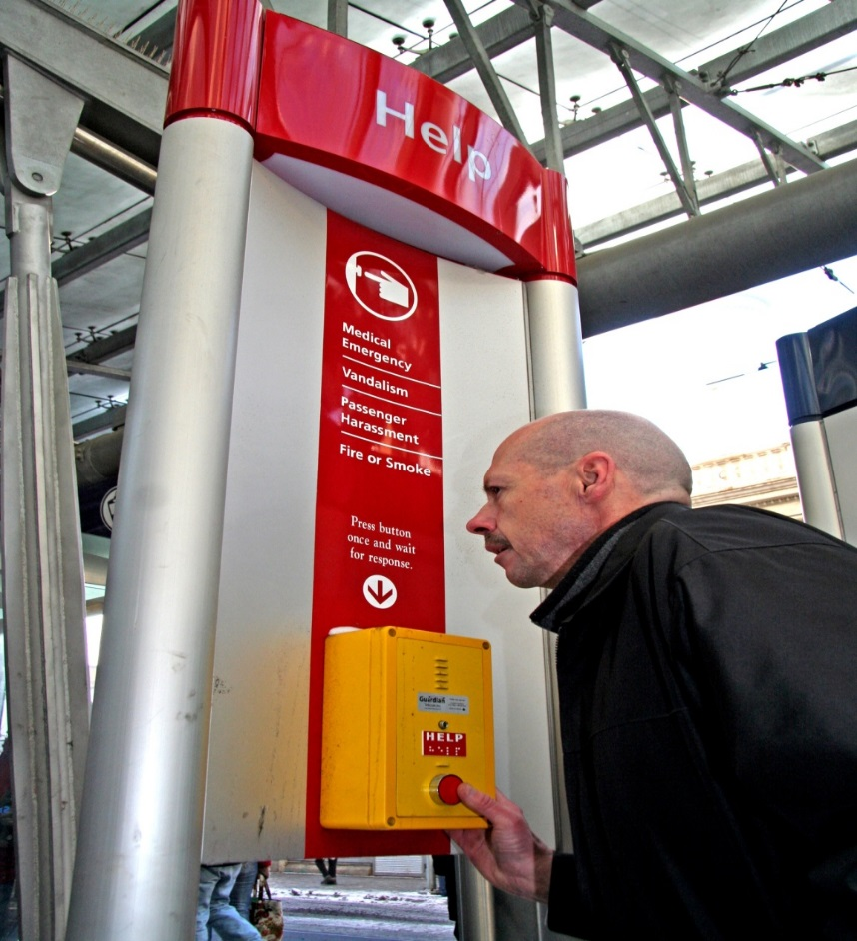
Ask for Help
Help Phones
Trains
Stations
Online
Twitter
Phone
Transit Watch (403) 262-1000
911 (Emergencies)
Transit Employee
Peace Officers
Notes:
Speaker #1
Specific locations of help phones on train (When boarding look for location of help phones or emergency strips)
Buttons
Strips
When a help phone button is pushed, cameras will automatically be displayed at the help phone, so that our dispatchers can see what is happening

Slide 14
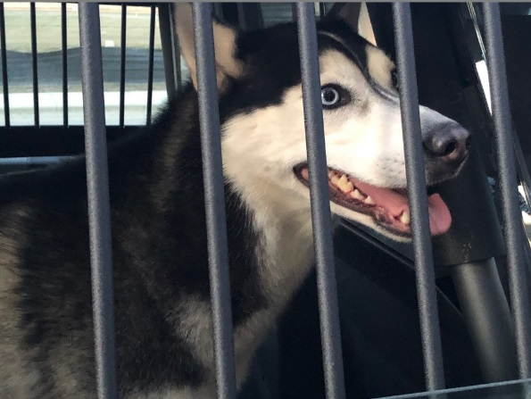
We’re Here to Help
No matter your size…
Notes:
Speaker #2
Speak about how we help animals as well, not just people
Stories
Kitty – Chicks
Jason – Dog boarded train, rode downtown and got off at City Hall

Slide 15
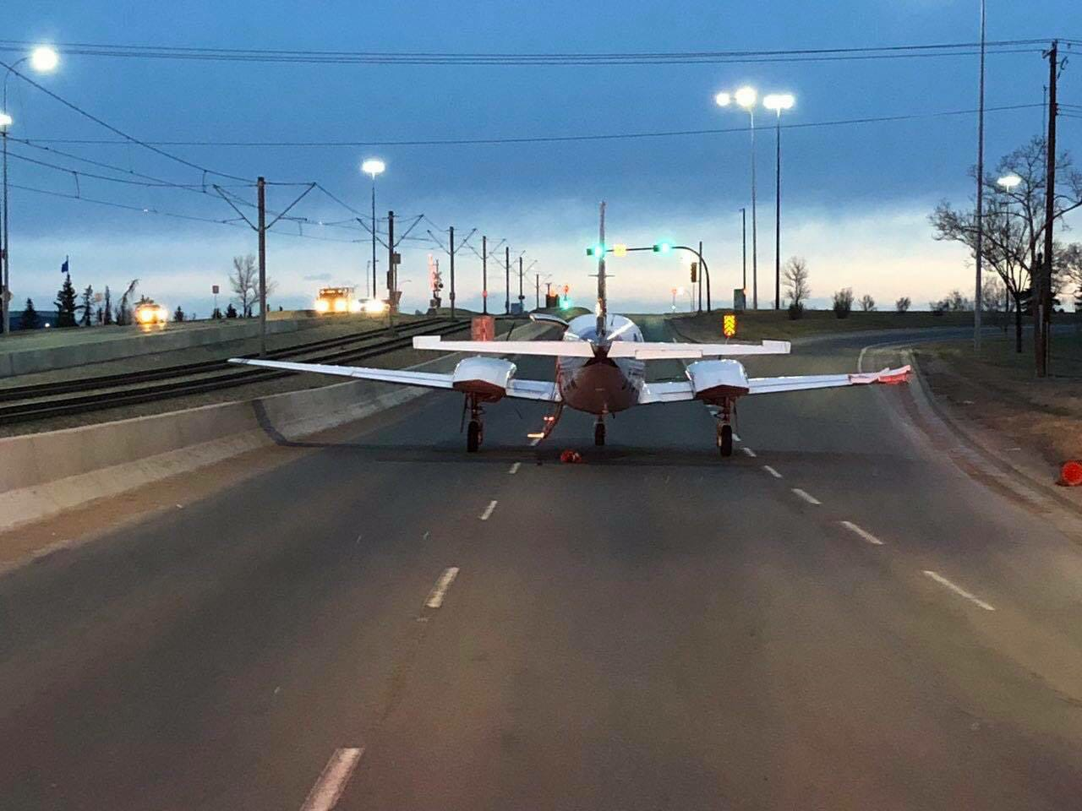
We’re Here to Help

Slide 16
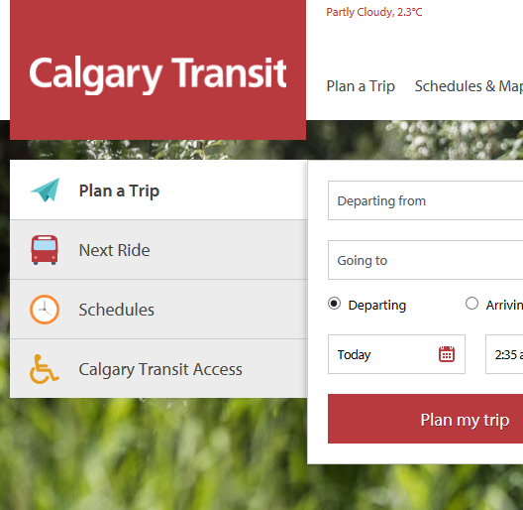
www.calgarytransit.com
Trip Planning
Schedules & Maps
Service Updates
Fare & Pass Info
Rider’s Guide

Slide 17
Question’s for Students
How heavy is a train?
How many cameras are on the transit system?
How many train stations do we have?
When would you ask for help?
What can you do if you need help?
Notes:
Answers
1) 98,500 lbs
2) 1300
3) 44
4) Various
5) Various

Slide 18
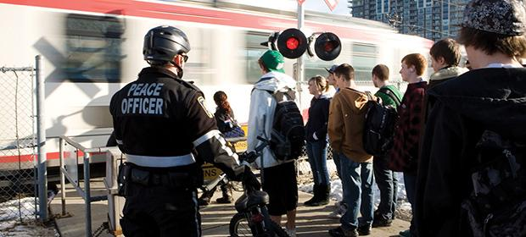
Questions?

