Slide 1
Archives in a Box ~ Dinosaurs ~
The City of Calgary Archives
http://Calgary.ca/archives
archives@calgary.ca

Slide 2
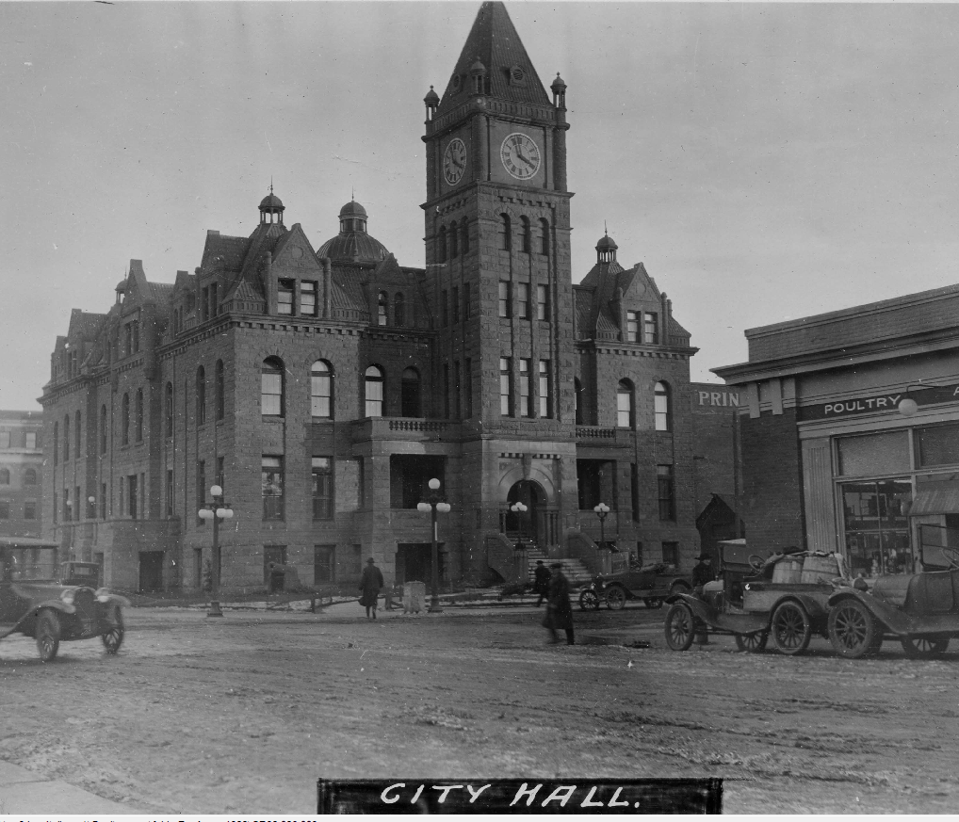
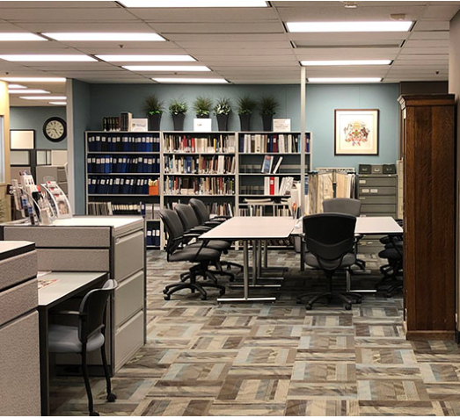
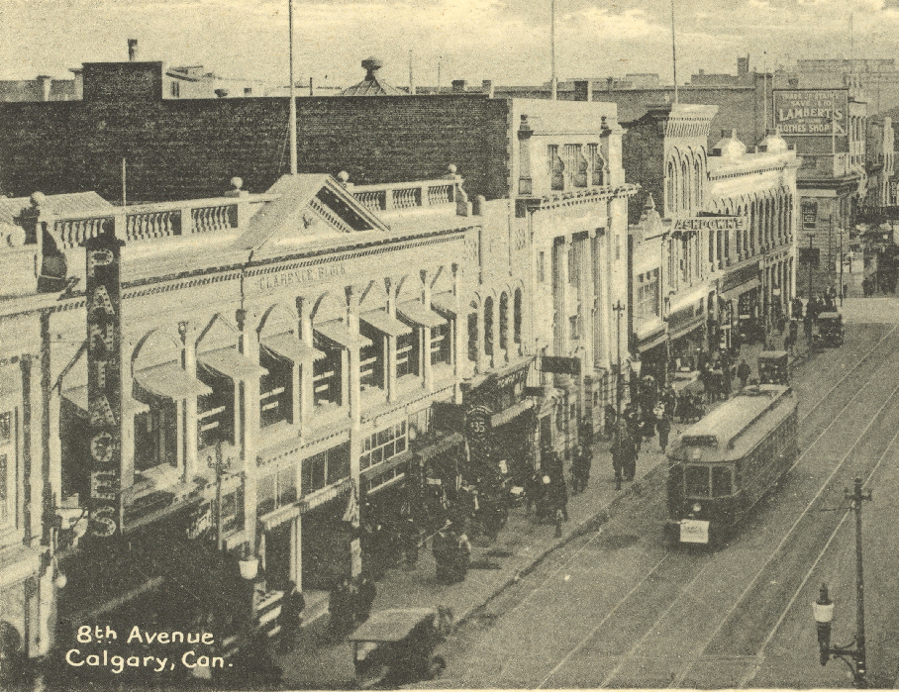
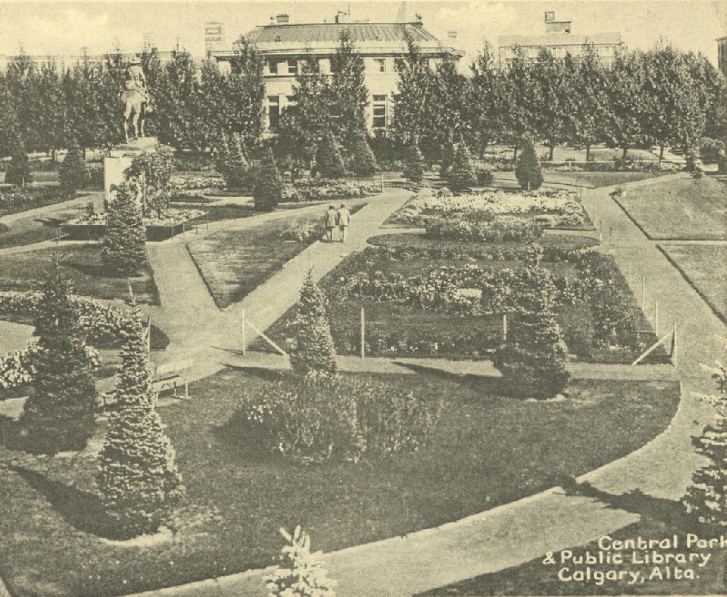
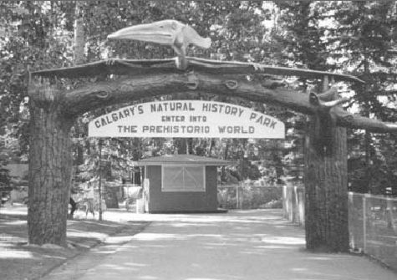
The City of Calgary Archives holds historic records created by The City
People can visit the Archives and search these records
These records tell the story of how the municipal government grew and provided services to the people
One of the services that has been provided since the early days of Calgary has been public parks
The Calgary Zoo was one of those parks

Slide 3
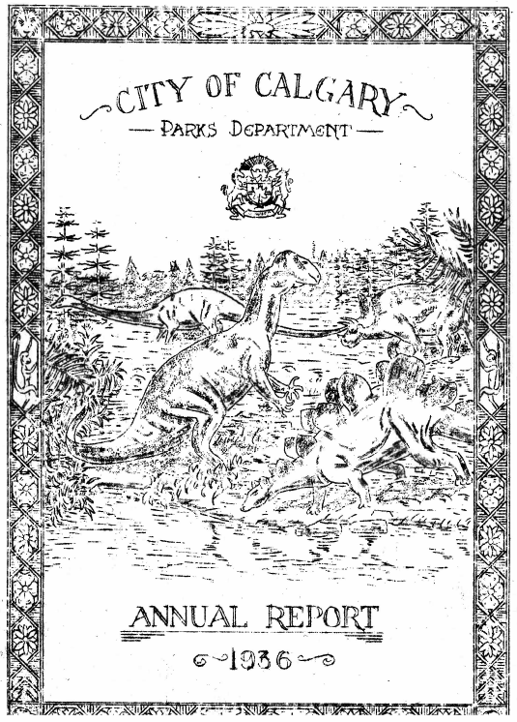
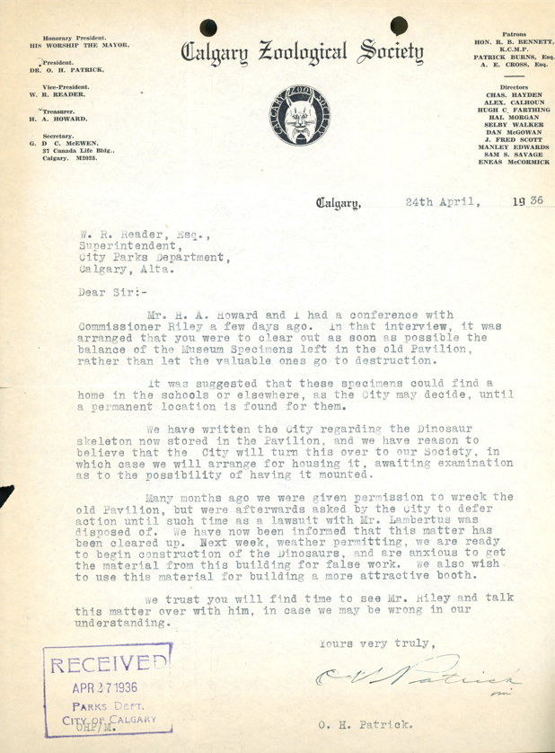
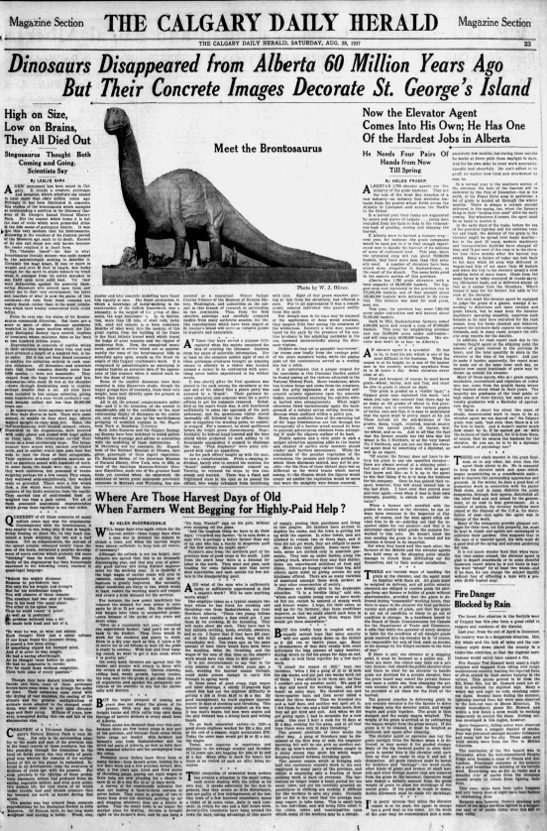
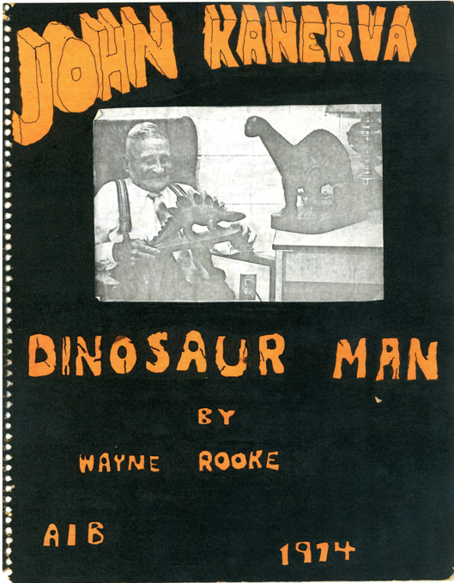
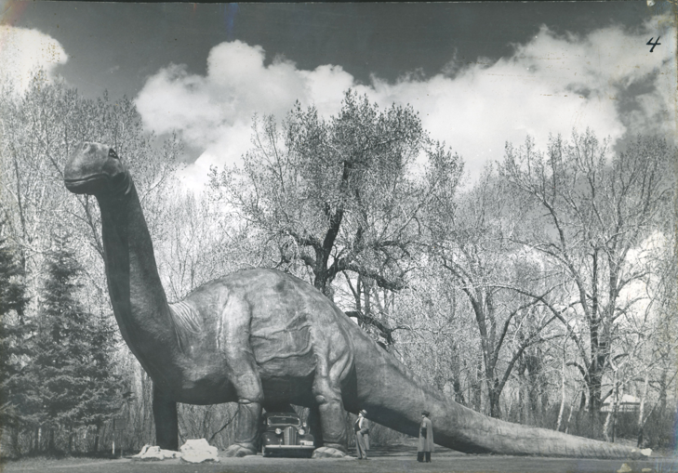
There are many types of records at the Archives with information about the Calgary Zoo
There are reports from city departments
Correspondence between the city and the public
Newspaper articles
Scrapbooks
And Photographs
By looking through these records you can discover the stories behind the history.

Slide 4
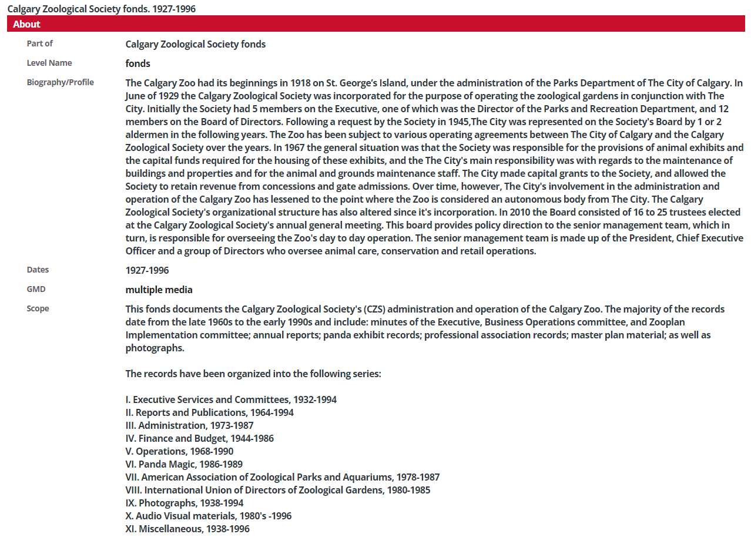
How is an Archives different than a library?
Libraries are organized by subject
Archival records are organized by who created the records
Understanding how The City is organized can help you locate information
E.g. The Calgary Zoological Society was responsible for the day to day operations of the zoo, but reported to The Parks and Recreation Department.
The City Clerks Department was responsible for bringing issues to City Council for decision making.
The City of Calgary Archives also has records from private organizations or citizens. These records can often provide additional understanding of city events or issues
e.g. scrapbooks or newspaper articles
It is important to note that the Archives may not hold copyright to records that were not created by The City.

Slide 5
How to use “Archives in a Box”
There are number of different kinds of records from different city departments and private citizens located inside of the box.
There is a quiz sheet looking for different facts that can be located within these records
Documents are numbered and match the teacher’s answer key
Documents can be distributed between groups
Be careful, as sometimes there is more than one possible answer.

Slide 6
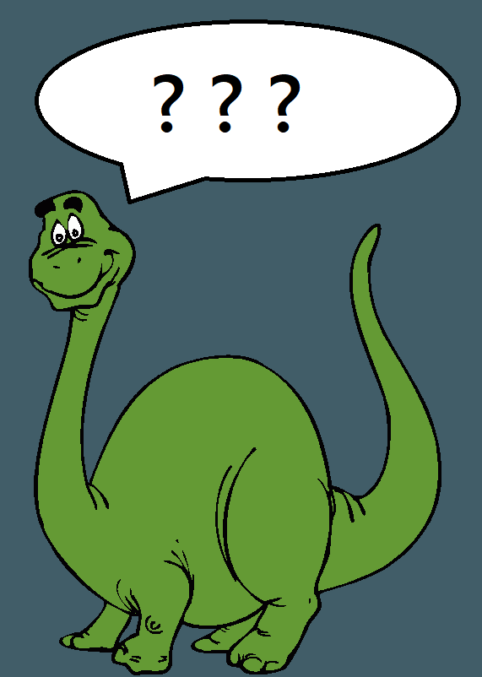
Some Big Questions to Explore
When there are different answers for the same question, how do we decide which one is right?
What types or sources of information are more likely to be reliable? Why?
How can you apply the idea of reliable information to information sources today?
Why do you think that there is more information available that is less reliable?

