Slide 1
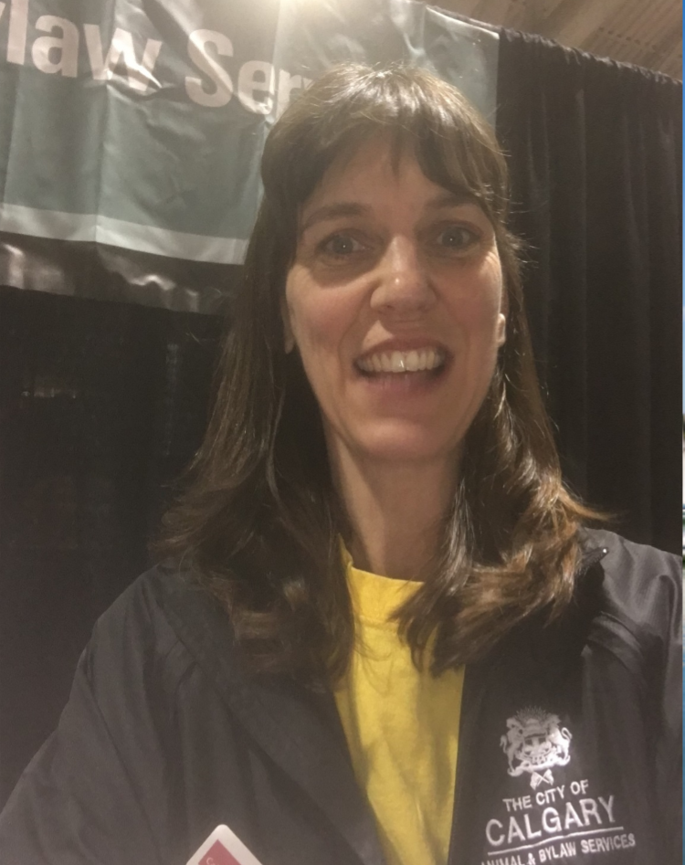
Hello!
My name is Janette Meyer
I work for The City of Calgary at the Animal & Bylaw Services Centre
as an Animal Behaviour Coordinator.
Training dogs, performing assessments to make sure that dogs and cats are safe for adoption, and working with public education with events such as the Safety Expo are some of the things that I do in my daily job.
.
Notes:
Work in the Animal & Bylaw Services Centre on Portland Street
Animal Shelter

Slide 2
Click on this video to learn about Communicating
with Dogs
Notes:
https://youtu.be/Oy5t_n6avrY

Slide 3
CALMING SIGNALS
What are Dog Calming Signals?
Calming signals are just what they sound like. They are behaviors offered by a dog in an attempt to keep a situation calm.
Dog’s calming signals can be both offered and returned. We can help our dogs feel comfortable by learning what their calming signals are and respecting them, and even by responding to them by repeating their gesture as best we can (tail wagging obviously excluded).
Natural dog behaviours, seen out of context and usually groups of behaviours or clusters.

Slide 4
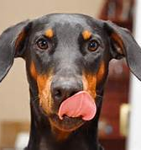
Calming Signals – Lip Licks

Slide 5
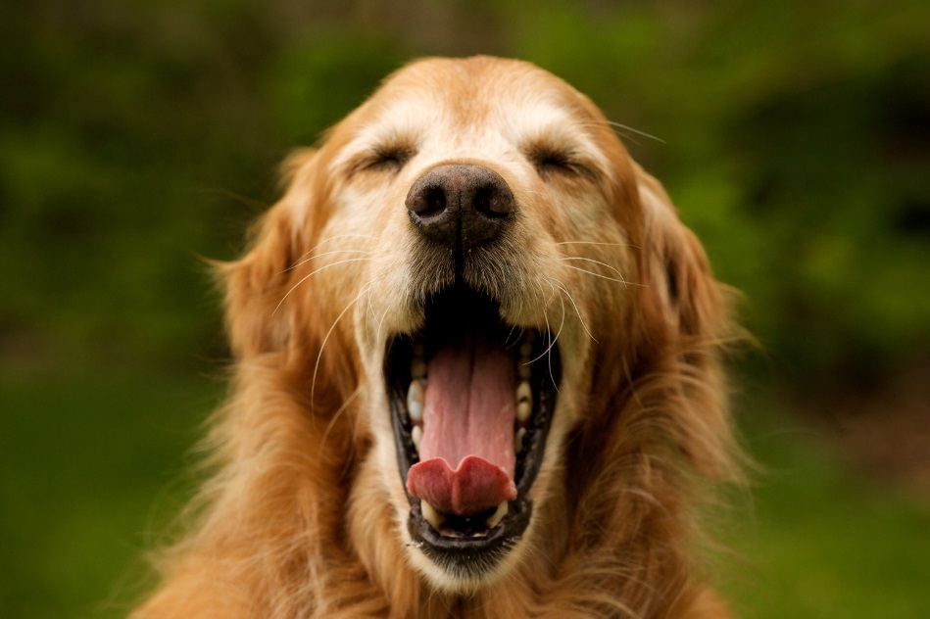
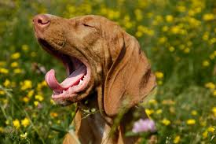
Calming Signals
Yawns

Slide 6
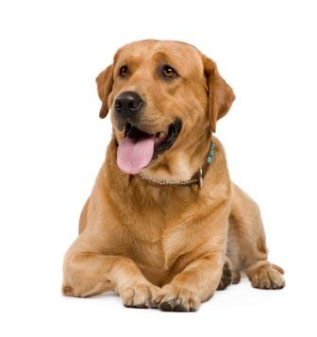
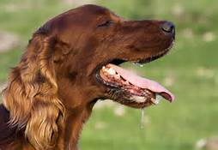
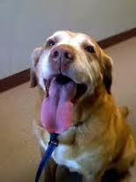
Panting

Slide 7
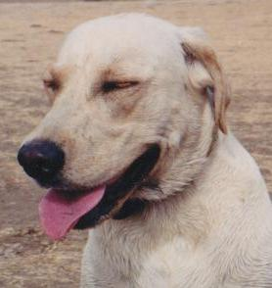
Blinking or Squinting

Slide 8
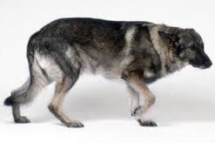
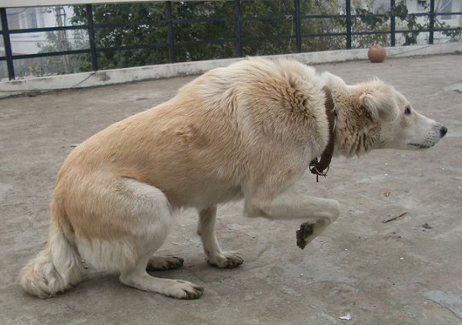
Paw Lift

Slide 9
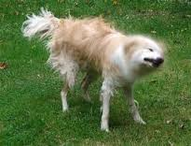
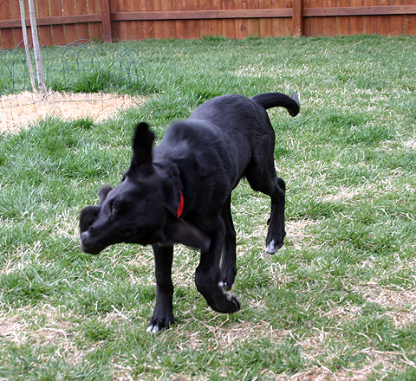
Shake-Off

Slide 10
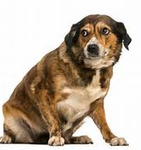
Looking Away
& Moving Away

Slide 11
Time Increasing Signals
THE DOG IS NOT COMFORTABLE IN THE SITUATION
PERFORMS CALMING SIGNAL BEHAVIOURS TO SLOW DOWN INTERACTION
Scratching
Sniffing ground – environmentally focused
Playbow

Slide 12
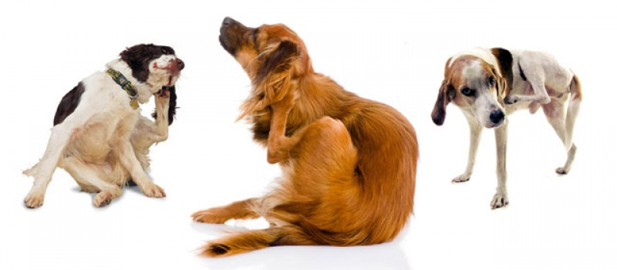
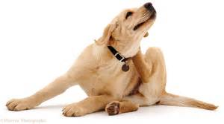
Scratching

Slide 13
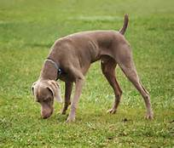
Sniffing

Slide 14
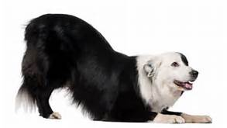
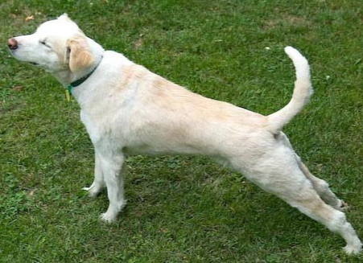
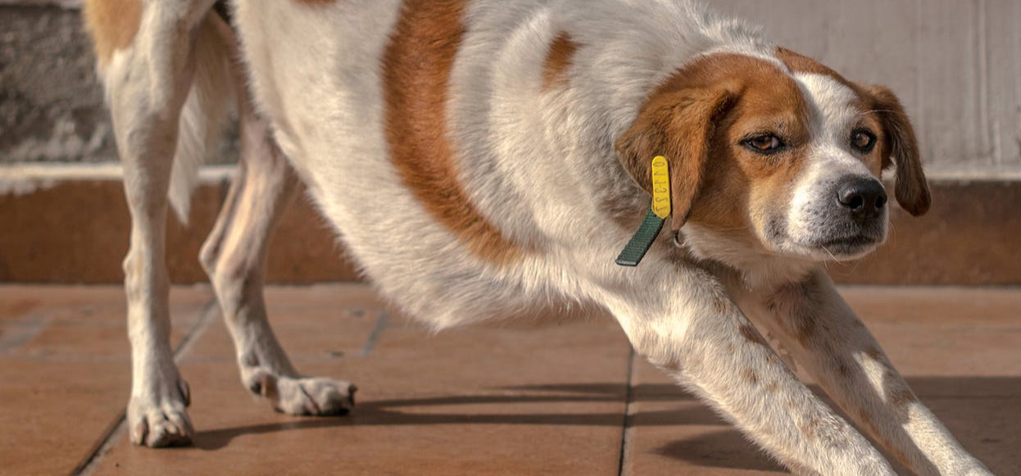
Stretching & Playbow

Slide 15
Calming signals can be subtle or obvious as seen in this video
Click to Play
Notes:
https://youtu.be/50juXRLhLUQ

Slide 16
Dog Skills
Can you spot the calming signals in this video?
Look for paw lifts, looking away, sniffing, shake-off and moving away.
How is she communicating with the other dog? How do you think she is feeling?
*Note to Teachers: Please mute the video to look for the visual cues.
Click Play
Notes:
https://youtu.be/Xga4qBml6Rw

Slide 17
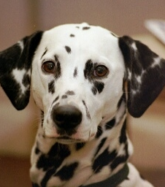
Thank you for
taking the time to understand
me!

Slide 18
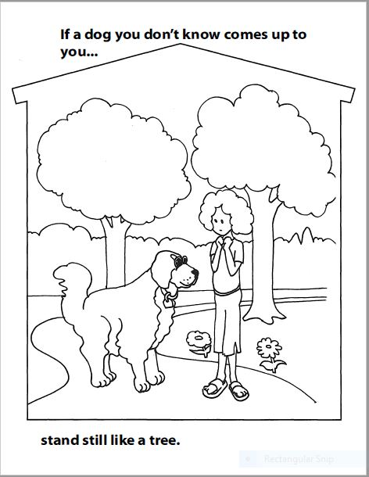
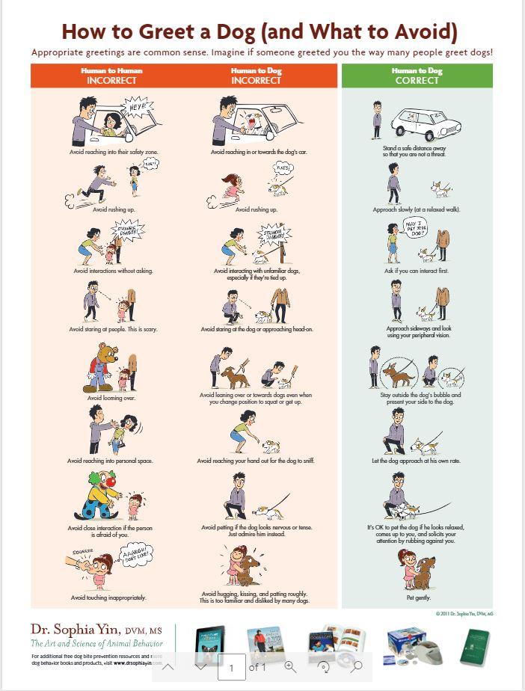
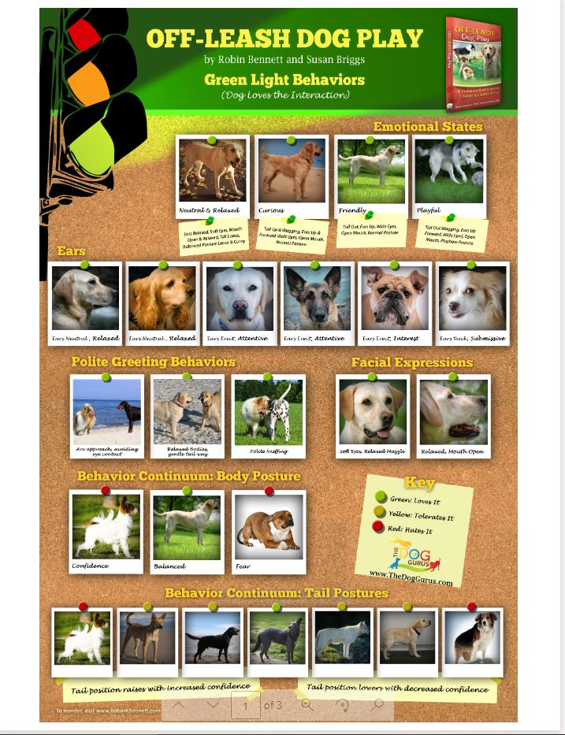
Have fun at the Safety Expo!
Check out the animal safety video, posters, activities and games!

