Slide 1
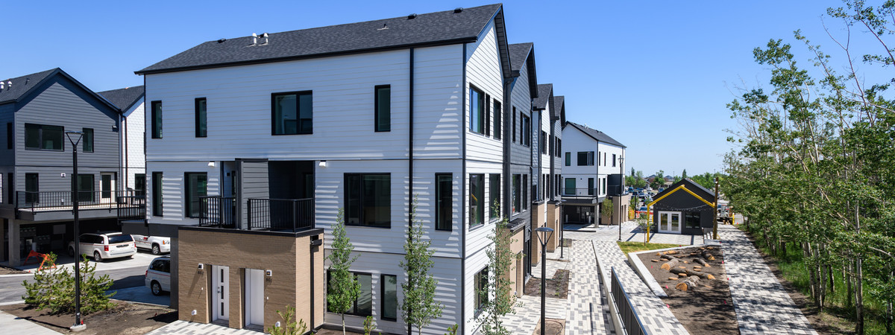
2023 Perspectives on Calgary Survey: Housing Affordability and Affordable Housing
The Corporate Research Team
Customer Service and Communications
The City of Calgary
research@calgary.ca
Final Report
September 2023

Slide 2
Acknowledgements
Land Acknowledgement
In the spirit of Reconciliation, we acknowledge that we live and work on the traditional territories of the Blackfoot Confederacy (Siksika, Kainai, Piikani), the Tsuut’ina, the Îyâxe Nakoda Nations (Bearspaw, Chiniki, Goodstoney), the Métis Nation (Region 3), and all people who make their homes in the Treaty 7 region of Southern Alberta. We acknowledge all Indigenous urban Calgarians who have made Calgary their home.

Slide 3
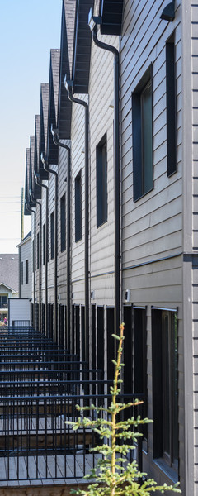
Table of contents
Background and methodology | 4
Key findings | 5
Detailed findings | 6
Housing affordability | 7
Housing Affordability Task Force recommendations | 9
Respondent profile | 24
Contact | 28
Appendix: questionnaire | 29

Slide 4
Background and methodology
Background
The City of Calgary surveys Calgarians about their opinions, preferences, and attitudes in order to help support data-driven City decision-making. The Perspectives on Calgary Survey is one of the ways by which data are collected, and this survey is conducted multiple times throughout the year.
For this wave of research, The City’s Corporate Research team partnered with the Housing Solutions division of the Partnerships Business Unit within the Community Services department, to understand Calgarians’ perceptions of housing affordability in Calgary, including Calgary's Housing Affordability Task Force policy recommendations.
Methodology
The survey was conducted by Advanis* from August 8th to 18th, 2023, with 500 Calgary residents aged 18 and older via a telephone survey. The average time to complete the survey was 17 minutes.
The survey was conducted using numbers from both landlines (21%) and cell phones (79%) to obtain a random and statistically-representative sample of Calgarians. To ensure the data was gathered from a representative group of Calgarians, sample quotas were set by age, gender, and city quadrant. For a full profile of survey respondents, please see pages 32 to 33.
The margin of error for the total sample of n=500 is ±4.0 percentage points, 19 times out of 20 (though smaller among subgroups of the total). Data were weighted based on the Statistics Canada 2021 Census of Population for age, gender, and city quadrant. Although the results are weighted, sample sizes for each question represent the number of actual respondents (i.e., unweighted n).
To note, some bar charts in this report do not add to 100% due to rounding.
*A third-party research company contracted by The City

Slide 5
Key findings
The majority of respondents consider both housing affordability* and affordable housing** to be significant issues in Calgary today
94% rate housing affordability as an issue, with 72% rating it as a significant issue
88% believe that affordable housing is an issue, with 66% rating it as a significant issue
Overall, the majority of respondents support the Housing Affordability Task Force (HATF) recommendations⁺
90% bringing together partners in the housing sector | 89% ensuring more people have a safe place to call home | 84% making more City-owned land available for below-market housing across the city
83% building more housing across the city, including allowing for a variety of housing forms | 82% increasing investment to support affordable housing providers | 75% ensuring affordable housing meets the needs of equity-deserving populations
*The amount a household pays for housing in relation to their total income.
**Housing projects that are often subsidized by government or other agencies.
⁺Descriptions of recommendations are abridged summaries. For full definitions presented to respondents, see pages 12 to 22.

Slide 6
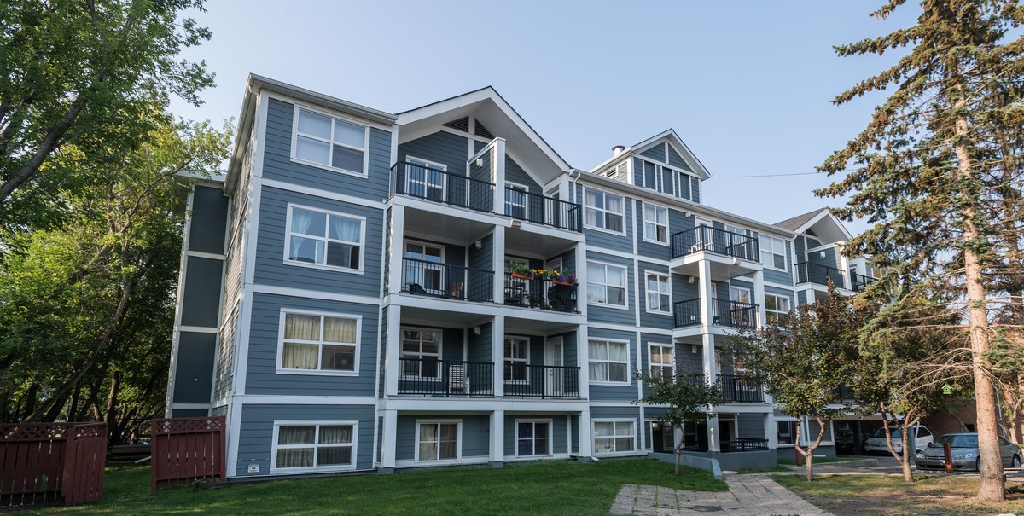
Detailed findings

Slide 7
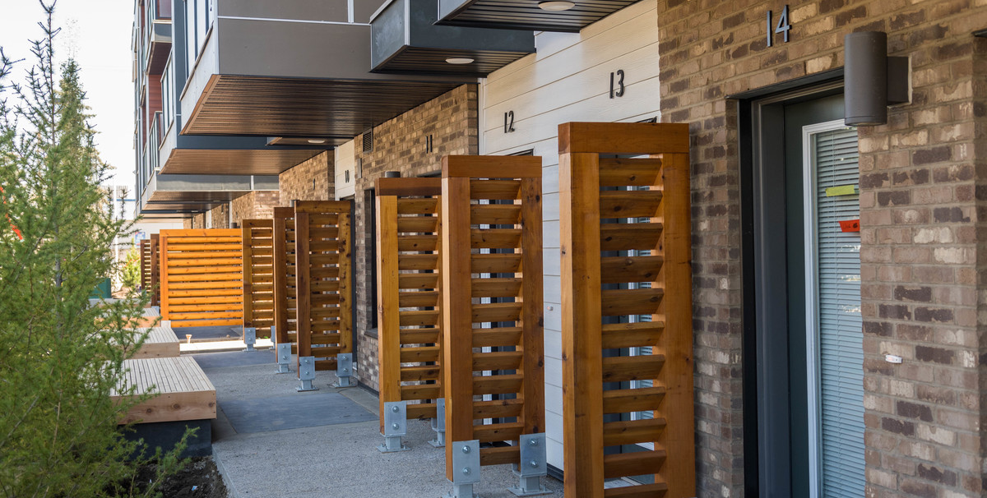
Housing affordability

Slide 8
Perceptions of housing affordability
The vast majority (94%) consider housing affordability to be an issue in Calgary today, with 72% rating it a significant issue. The majority (88%) also consider affordable housing to be an issue, with 66% rating it as a significant issue.
Is an issue
94%
88%
Q. The next question is about housing affordability and affordable housing in Calgary. By housing affordability I’m referring to the amount a household pays for housing in relation to their total income, while affordable housing refers to housing projects that are often subsidized by government or other agencies. For each of these, please tell me if it is a significant issue, somewhat of an issue, not really an issue, or not an issue at all in the city of Calgary today.
Base: Valid respondents (n=500)
Labels <4% not shown

Slide 9
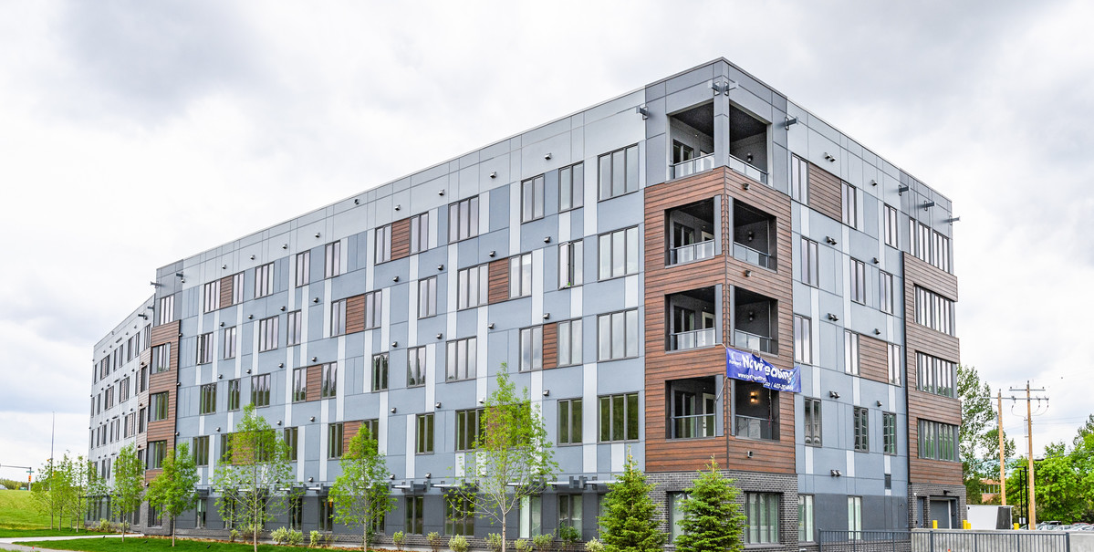
Housing Affordability Task Force (HATF) recommendations

Slide 10
HATF recommendations: question methodology
Respondents were asked to rate their level of support for each of the six Housing Affordability Task Force recommendations. The recommendations were presented to respondents in a randomized order, and those who did not “strongly support” a recommendation were asked to explain the concerns they may have with it.
Before answering these questions, respondents were read the following preamble:
“Calgary’s Housing and Affordability Task Force recently presented several recommendations related to housing policy in Calgary, from homelessness to market housing. The Task Force was made up of 15 members who made these recommendations to City Council.
The next questions are about your opinions on the Task Force’s recommendations.”

Slide 11
Summary of perceptions of HATF recommendations
Overall, the majority support each HATF recommendation. Recommendations 4 and 6 garnered the most support (90% and 89%, respectively). While still supported by the majority (75%), recommendation 3 saw the lowest level of support.
Support
90%
89%
84%
83%
82%
75%
Q. [Explanation of recommendation.] To what extent do you support or oppose this recommendation?
Base: Valid respondents (n=500)
*Chart labels are abridged summaries of each recommendation. For full questions, see pages 12 to 22.
Labels <4% not shown

Slide 12
Recommendation 1: building more housing across the city
The majority (83%) support the recommendation to build more housing across the city, including allowing for a variety of housing forms, with 45% strongly supporting it.
Support:
83%
Oppose:
16%*
Q. The Task Force recommended building more housing across the city, including allowing for a variety of housing forms, such as a single detached home, semi-detached and rowhouses on parcels that currently only allow for a single detached home and 1 suite. This doesn’t mean that all parcels will redevelop, but if a property owner wants to redevelop, there are opportunities for more housing choice whenever redevelopment becomes an option for that property owner. It also includes creating incentives for more affordable market and non-market housing. To what extent do you support or oppose this recommendation?
Base: Valid respondents (n=500)
*Rounding

Slide 13
Concerns with recommendation 1: building more housing across the city
Respondents that did not “strongly support” recommendation 1 (n=277) were asked what concerns, if any, they had with it. Concerns related to population density, overcrowding and/or infrastructure was the top response (28%).
Concerns with recommendation 1 | % (n=277)
Population density / overcrowding / infrastructure concerns | 28%
Opposed to recommendation (in general) | 10%
Parking concerns | 10%
Concerns about people (residents, homeowners, homebuilders, etc) taking advantage of the system | 8%
House prices / market value concerns | 6%
Concerns about livability of new housing | 4%
Concerns about costs / tax increases / loss of assets for The City | 4%
Concerns about new housing actually being affordable | 4%
Policies should focus on addressing housing affordability for other demographics / everyone | 4%
Safety concerns | 4%
Other | 3%
Don’t have concerns / agree with recommendation | 13%
Don’t know / need more information | 19%
Open-ended comments
Q. What concerns, if any, do you have with this recommendation?
Base: Respondents that did not “strongly support” recommendation 1 (n=277)
Multiple responses allowed
Mentions <3% not shown

Slide 14
Recommendation 2: making more land available for below-market housing
The majority (84%) support the recommendation to make more City-owned land available to create more below-market housing across the city, with 48% strongly supporting it.
Support:
84%
Oppose:
12%
Q. The Task Force recommended making more City-owned land available to create more below-market housing across the city. Tasks to achieve this would include using existing City land or providing funding to create non-market housing, identifying City-owned land that can be used to build new affordable housing units, and making it easier for non-market housing builders to access City-owned land. To what extent do you support or oppose this recommendation?
Base: Valid respondents (n=500)

Slide 15
Concerns with recommendation 2: making more land available for below-market housing
Loss of green spaces (16%) and costs, tax increases or a loss of assets for The City (12%) were the top mentioned concerns of respondents that did not "strongly support" recommendation 2 (n=247).
Concerns with recommendation 2 | % (n=247)
Loss of green spaces | 16%
Concerns about costs / tax increases / loss of assets for The City | 12%
Population density / overcrowding / infrastructure concerns | 9%
Concerns about people (residents, homeowners, homebuilders, etc) taking advantage of the system | 7%
Concerns about implementation / feasibility | 7%
City-owned land should be used for other purposes (schools, businesses, recreation, etc.) | 7%
House prices / market value concerns | 4%
Policies should focus on addressing housing affordability for other demographics / everyone | 4%
Concerns about new housing actually being affordable | 3%
Opposed to recommendation (in general) | 3%
Lack of trust in government / ability of government to solve issue | 3%
Government should have other priorities | 3%
Other | 4%
Don’t have concerns / agree with recommendation | 9%
Don’t know / need more information | 25%
Open-ended comments
Q. What concerns, if any, do you have with this recommendation?
Base: Respondents that did not “strongly support” recommendation 2 (n=247)
Multiple responses allowed
Mentions <3% not shown

Slide 16
Recommendation 3: supply that meets the needs of equity-deserving populations
75% support the recommendation of ensuring the affordable housing supply meets the needs of Indigenous peoples in Calgary and equity-deserving populations, with 46% strongly supporting it.
Support:
75%
Oppose:
21%
Q. The Task Force recommended that the supply of affordable housing meets the needs of Indigenous people living in Calgary and equity deserving populations. This would include reducing barriers to accessing housing, and making more land and funding available to build more housing that is culturally appropriate. [Interviewer Note: “Equity deserving populations” includes those facing barriers due to gender identity, race, sexual orientation, physical abilities, or other characteristics.] To what extent do you support or oppose this recommendation?
Base: Valid respondents (n=500)

Slide 17
Concerns with recommendation 3: supply that meets the needs of equity-deserving populations
Feeling that housing affordability policies should focus on other demographics, or everyone, was the top concern among those not strongly supporting recommendation 3 (n=272), mentioned by 30% of these respondents.
Concerns with recommendation 3 | % (n=272)
Policies should focus on addressing housing affordability for other demographics / everyone | 30%
Equity-deserving populations receive other supports | 9%
Opposed to recommendation (in general) | 8%
Concerns about implementation / feasibility | 5%
Concerns about costs / tax increases / loss of assets for The City | 4%
Other | 4%
Don’t have concerns / agree with recommendation | 10%
Don’t know / need more information | 26%
Open-ended comments
Q. What concerns, if any, do you have with this recommendation?
Base: Respondents that did not “strongly support” recommendation 3 (n=272)
Multiple responses allowed
Mentions <3% not shown

Slide 18
Perceptions of recommendation 4: housing sector partner collaboration
The majority (90%) support the recommendation of bringing together partners in the housing sector, and 59% strongly support it.
Support:
90%
Oppose:
8%*
Q. The Task Force recommended that The City brings together partners in the housing sector to collaborate on developing new housing supply, reducing stigma, and building more awareness in the community about affordable housing, permanent supportive housing, and homelessness. To what extent do you support or oppose this recommendation?
Base: Valid respondents (n=500)
*Rounding

Slide 19
Concerns with recommendation 4: housing sector partner collaboration
Of those not strongly supporting recommendation 4 (n=200), concerns about people taking advantage of the system (10%), implementation or feasibility (9%) as well as costs or tax increases (8%) were the top mentioned reasons.
Concerns with recommendation 4 | % (n=200)
Concerns about people (residents, homeowners, homebuilders, etc) taking advantage of the system | 10%
Concerns about implementation / feasibility | 9%
Concerns about costs / tax increases / loss of assets for The City | 8%
Policies should focus on addressing housing affordability for other demographics / everyone | 6%
Opposed to recommendation (in general) | 5%
Concerns about new housing actually being affordable | 4%
Concerns that this will not fix homelessness | 4%
Population density / overcrowding / infrastructure concerns | 3%
Lack of trust in government / ability of government to solve issue | 3%
House prices / market value concerns | 3%
Safety concerns | 3%
Other | 9%
Don’t have concerns / agree with recommendation | 12%
Don’t know / need more information | 28%
Open-ended comments
Q. What concerns, if any, do you have with this recommendation?
Base: Respondents that did not “strongly support” recommendation 4 (n=200)
Multiple responses allowed
Mentions <3% not shown

Slide 20
Recommendation 5: increase investment to support affordable housing providers
82% support the recommendation to increase investment to support affordable housing providers, with 49% strongly agreeing.
Support:
82%
Oppose:
16%*
Q. The Task Force recommended increasing investment to support affordable housing providers, which would include advocating to the provincial and federal governments for affordable housing funding, and eliminating property taxes for non-profit organizations that provide affordable housing. To what extent do you support or oppose this recommendation?
Base: Valid respondents (n=500)
*Rounding

Slide 21
Concerns with recommendation 5: increase investment to support affordable housing providers
Of those who did not strongly support recommendation 5 (n=256), the top concerns were around costs or tax increases (20%) and not being in favour of completely eliminating property taxes for non-profit organizations (19%).
Concerns with recommendation 5 | % (n=256)
Concerns about costs / tax increases / loss of assets for The City | 20%
Not in favor of completely eliminating property taxes for non-profit organizations | 19%
Concerns about people (residents, homeowners, homebuilders, etc) taking advantage of the system | 9%
Concerns about non-profit organizations (e.g. belief that they will take advantage/profit off of government support) | 5%
Lack of trust in government / ability of government to solve issue | 5%
Concerns that this will not fix homelessness | 3%
Other | 3%
Don’t have concerns / agree with recommendation | 12%
Don’t know / need more information | 24%
Open-ended comments
Q. What concerns, if any, do you have with this recommendation?
Base: Respondents that did not “strongly support” recommendation 5 (n=256)
Multiple responses allowed
Mentions <3% not shown

Slide 22
Recommendation 6: ensure more people have a safe place to call home
89% support, and 61% strongly support, the recommendation to ensure more people have a safe place to call home, which involves improving living conditions for people in rental housing.
Support:
89%
Oppose:
9%*
Q. The Task Force recommended making sure more people have a safe place to call home. Tasks to achieve this would include increasing renters’ awareness of their rights, looking at rent-control models used in other cities or provinces, advocating to the Province to improve minimum health and housing standards, and funding programs that can prevent Calgarians from becoming unhoused. To what extent do you support or oppose this recommendation?
Base: Valid respondents (n=500)
*Rounding

Slide 23
Concerns with recommendation 6: ensure more people have a safe place to call home
Rent control issues (19%) are the top concern among respondents not strongly supporting recommendation 6 (n=202), including rent controls negatively affecting landlords or homeowners (6%).
Concerns with recommendation 6 | % (n=202)
NET Issues with rent control | 19%
Concerns about / not in favor of rent control (other / general comments) | 8%
Rent control negatively affects landlords / homeowners | 6%
Rent control doesn’t work / is not effective | 4%
Rent control interferes with the free market / competition | 3%
Concerns about costs / tax increases / loss of assets for The City | 8%
Opposed to recommendation (general mentions) | 6%
Concerns about people (residents, homeowners, homebuilders, etc) taking advantage of the system | 5%
Concerns about implementation / feasibility | 5%
Government should have other priorities | 4%
Lack of trust in government / ability of government to solve issue | 3%
Population density / overcrowding / infrastructure concerns | 3%
Other | 4%
Don’t have concerns / agree with recommendation | 18%
Don’t know / need more information | 25%
Open-ended comments
Q. What concerns, if any, do you have with this recommendation?
Base: Respondents that did not “strongly support” recommendation 6 (n=202)
Multiple responses allowed
Mentions <3% not shown

Slide 24

Respondent profile

Slide 25
Housing spending
On average, respondents indicated they spend one-third (33%) of their monthly household income before tax on housing. Among those spending 30% or more on housing, 27% indicated their annual household income is less than $60,000*. Conversely, among those spending less than 30% of their monthly household income before tax on housing, only 8% have an annual household income less than $60,000.
Q. Approximately what percentage of your total monthly household monthly income, before tax, would you say you spend on the rent or mortgage payment for the home you currently live in? / Q. Can you tell me whether you think you spend more than or less than thirty percent of your total monthly household income before tax on your rent or mortgage? / Q. Which of the following categories best describes the total annual income, before taxes, of all the members of your household?
Base: Those who provided a response (see base sizes in chart)
*Reflects the housing affordability threshold (earn less than 65% of the Calgary Area Median Income)

Slide 26
Respondent profile
Home ownership
Own | 65%
Rent | 33%
Neither / other | 1%
Prefer not to answer | <1%
Home type
Single-detached | 59%
Apartment or apartment-style condo building | 19%
Duplex or semi-detached | 9%
Townhouse | 8%
Another type of multi-unit complex | 4%
Rowhouse | 1%
Don’t know / prefer not to answer | 1%
Quadrant
Southwest | 28%
Southeast | 24%
Northwest | 28%
Northeast | 20%
Household income
Less than $60,000 | 20%
$60,000 to <$120,000 | 39%
$120,000 to <$200,000 | 21%
$200,000 and over | 12%
Don’t know | 2%
Prefer not to answer | 6%
Years living in current home
5 years or less | 47%
6 to 10 years | 16%
11 to 20 years | 19%
More than 20 years | 17%
Don’t know | <1%
Number of people in household
1 | 17%
2 | 34%
3 - 4 | 38%
5 or more | 11%
Prefer not to answer | 1%
Household composition
Children in household | 32%
Seniors in household | 26%
Location in Calgary
Inner city | 24%
Outside inner city | 76%
Base: Valid respondents (n=500)

Slide 27
Respondent profile (continued)
Age
18 to 24 | 5%
25 to 34 | 24%
35 to 44 | 17%
45 to 54 | 21%
55 to 64 | 14%
65 or older | 19%
Gender
Female | 50%
Male | 50%
Prefer to self-describe | <1%
Prefer not to answer | <1%
Born in Canada
Yes | 74%
No | 26%
Prefer not to answer | <1%
Racialized*
Yes | 22%
No | 75%
Prefer to self-describe | 1%
Prefer to not to answer | 2%
LGBTQ2S+ community
Yes | 8%
No | 90%
Prefer not to answer | 2%
Years lived in Calgary
Less than 5 years | 7%
5 to 10 years | 12%
11 to 20 years | 21%
21 to 30 years | 23%
More than 30 years | 37%
Indigenous identity*
Yes – First Nations | 1%
Yes – Métis | 5%
Yes - Prefer to self-describe | <1%
Yes – Inuit | 0%
No | 94%
Prefer not to answer | <1%
Disability in household*
Yes – myself | 10%
Yes – someone in my household | 9%
No | 83%
Prefer not to answer | 2%
*Multiple responses allowed
Base: Valid respondents (n=500)

Slide 28

Contact
The Corporate Research Team
Customer Service and Communications
The City of Calgary
research@calgary.ca

Slide 29
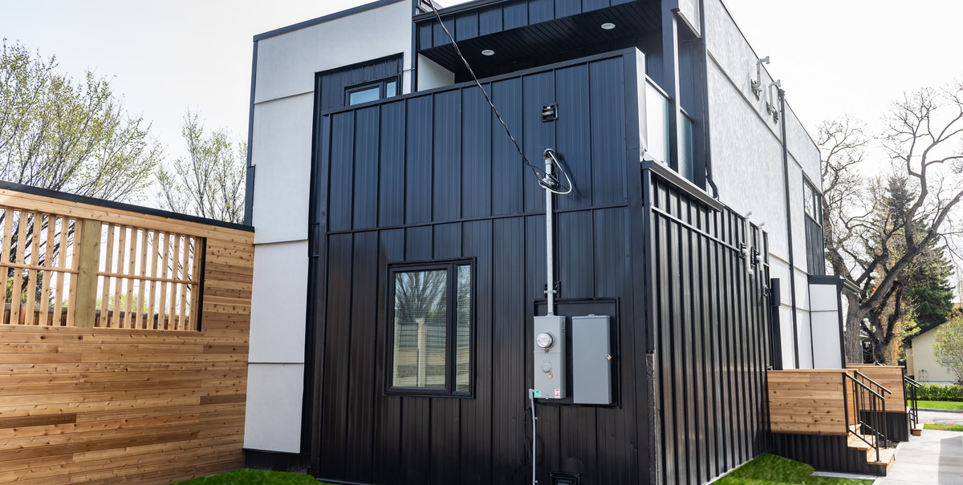
Appendix: questionnaire

Slide 30
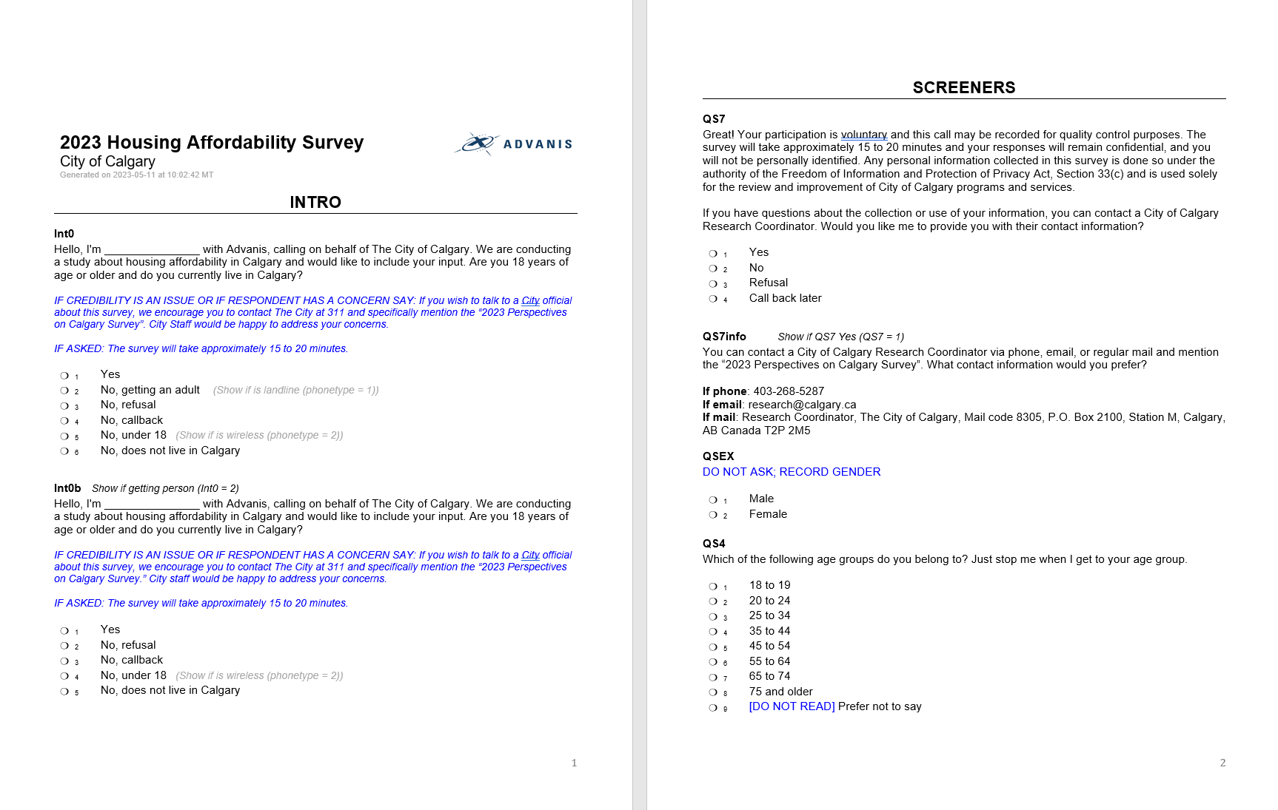
Questionnaire

Slide 31
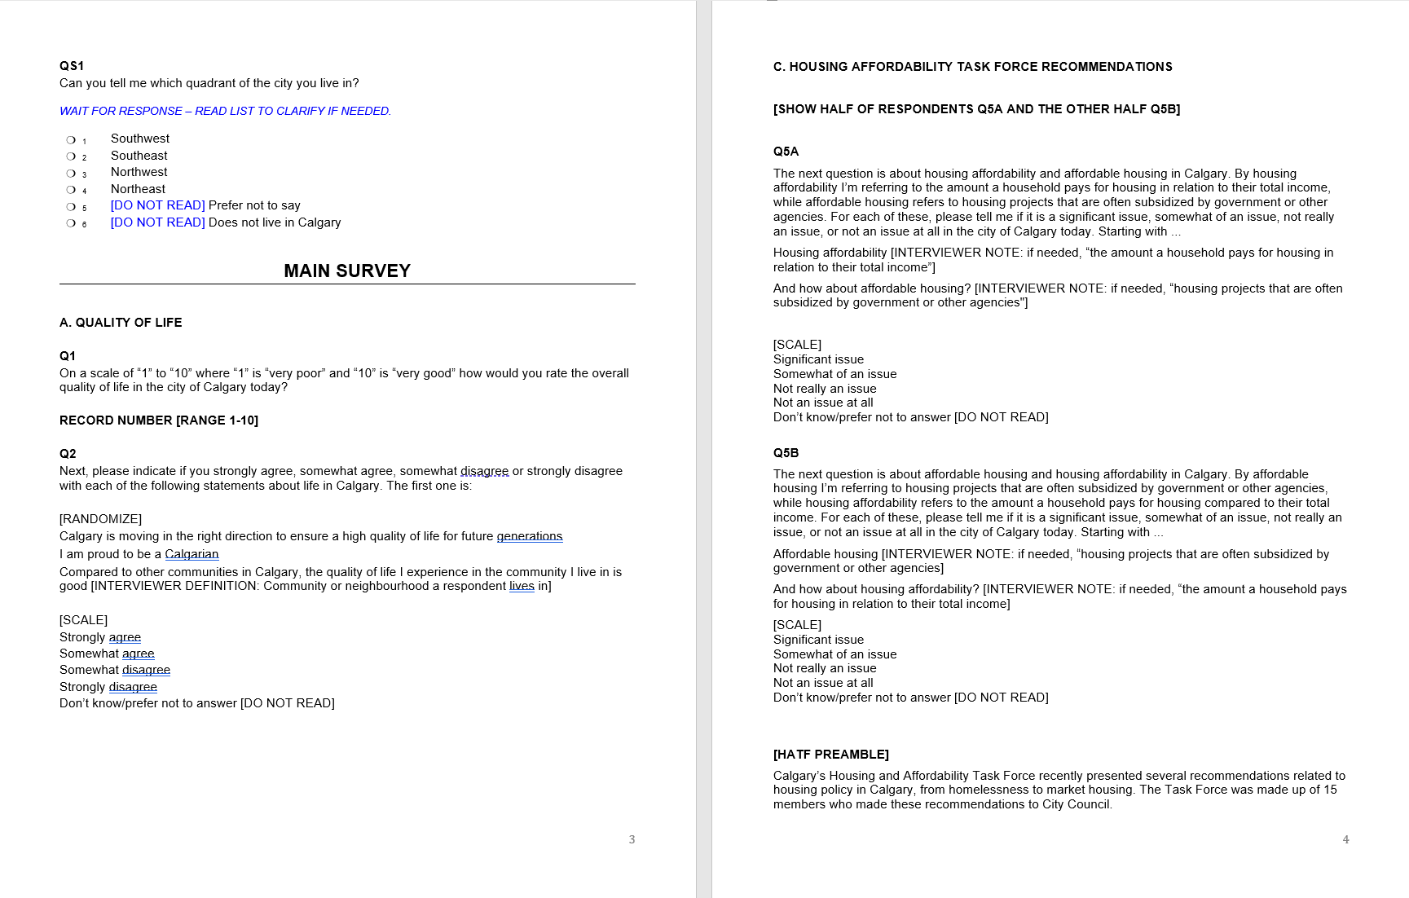
Questionnaire (continued)

Slide 32
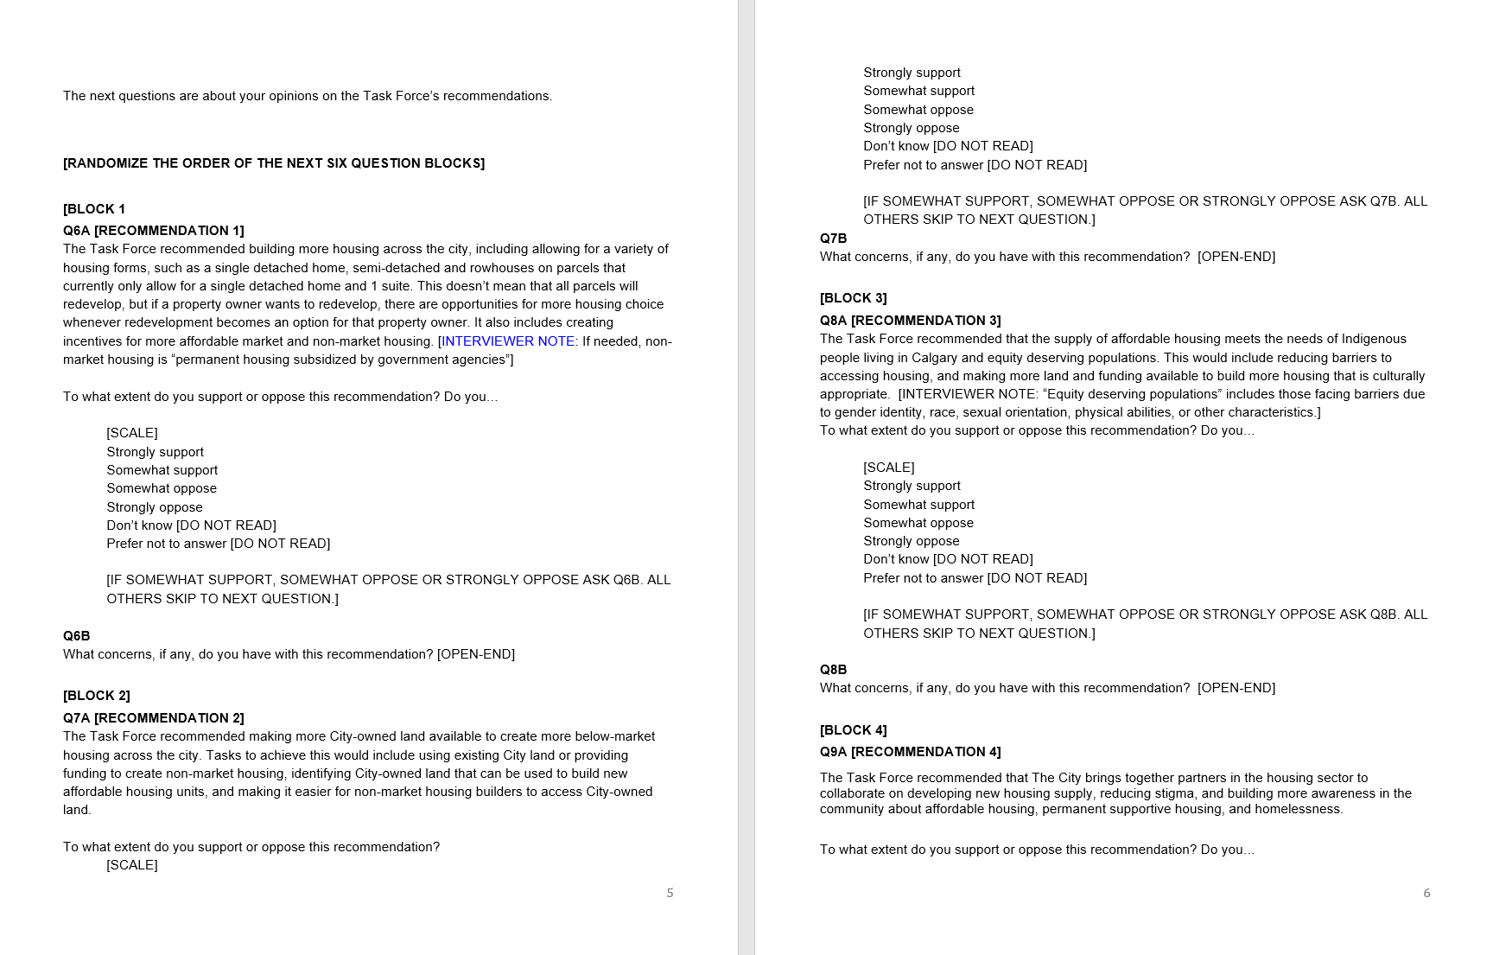
Questionnaire (continued)

Slide 33
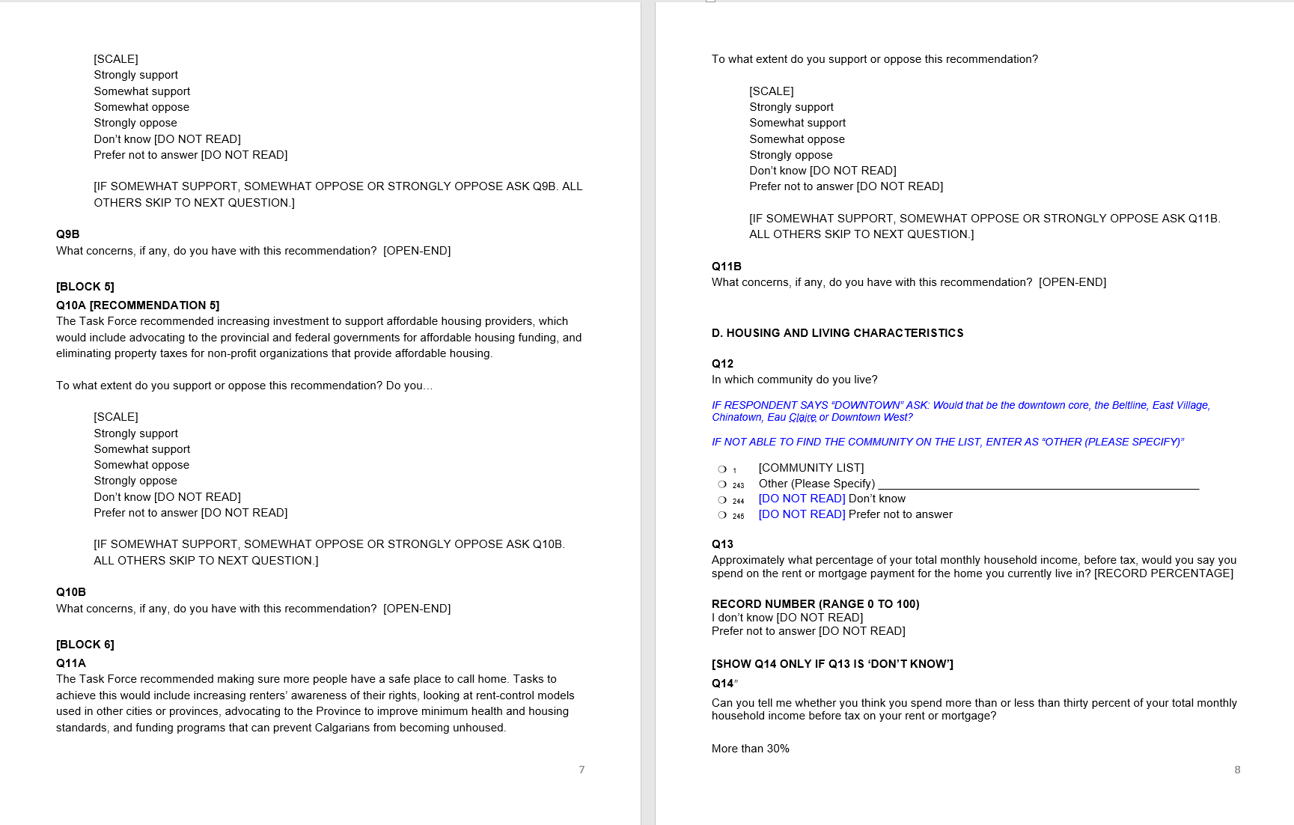
Questionnaire (continued)

Slide 34
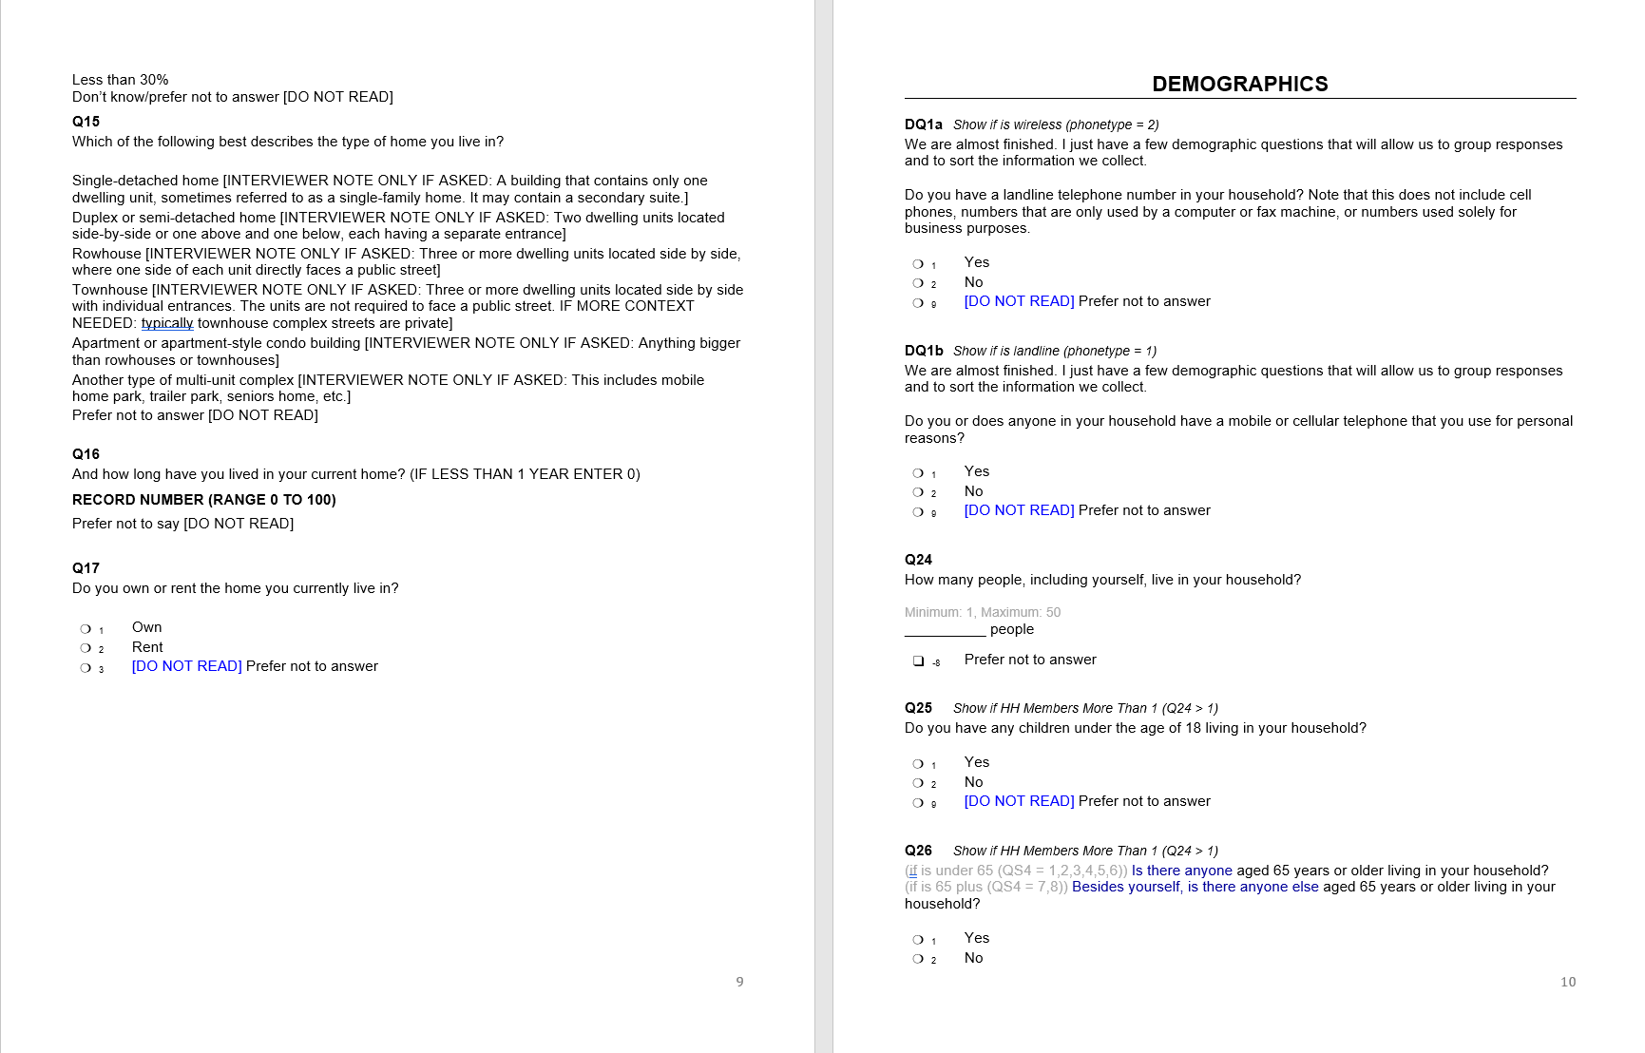
Questionnaire (continued)

Slide 35
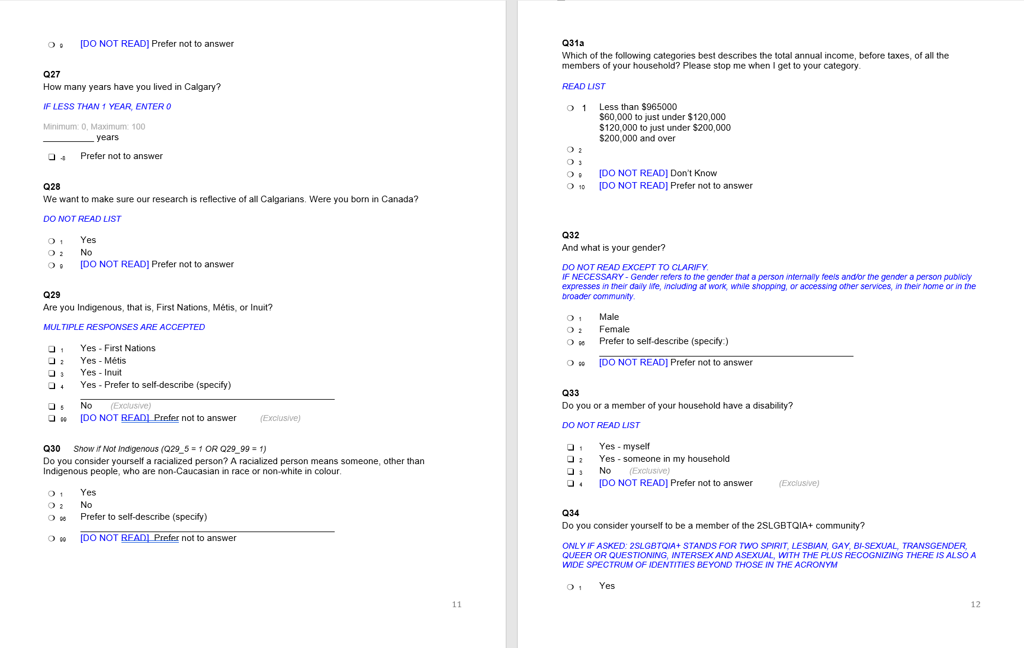
Questionnaire (continued)

Slide 36

Questionnaire (continued)

